Slide 1

Chapter 19
Network Layer:
Logical Addressing
19.<number>
Copyright © The McGraw-Hill Companies, Inc. Permission required for reproduction or display.

Slide 2
19-1 IPv4 ADDRESSES
An IPv4 address is a 32-bit address that uniquely and universally defines the connection of a device (for example, a computer or a router) to the Internet.
Topics discussed in this section:
Address Space
Notations
Classful Addressing
Classless Addressing
Network Address Translation (NAT)
19.<number>

Slide 3

Note
An IPv4 address is 32 bits long.
The IPv4 addresses are unique
and universal (all nodes connecting Internet must have IP addresses).
The address space of IPv4 is
2³² or 4,294,967,296.
19.<number>

Slide 4

Figure 19.1 Dotted-decimal notation and binary notation for an IPv4 address
19.<number>

Slide 5
Note
Numbering systems are reviewed in Appendix B.
19.<number>

Slide 6
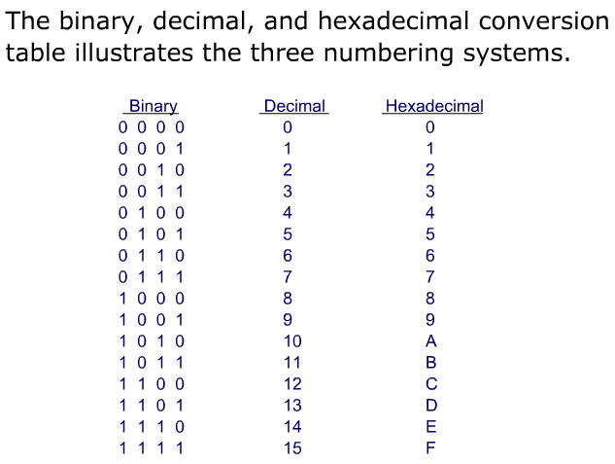
Obtained from http://www.wisc-online.com
19.<number>

Slide 7
Note
A very good tutorial on Binary, Hexadecimal, and Decimal conversion can be found on Wisc Online:
http://www.wisc-online.com/Objects/ViewObject.aspx?ID=DIG1102
19.<number>

Slide 8


Example 19.1
Change the following IPv4 addresses from binary notation to dotted-decimal notation.
Solution
We replace each group of 8 bits with its equivalent decimal number (see Appendix B) and add dots for separation.
19.<number>

Slide 9


Example 19.2
Change the following IPv4 addresses from dotted-decimal notation to binary notation.
Solution
We replace each decimal number with its binary equivalent (see Appendix B).
19.<number>

Slide 10

Example 19.3
Find the error, if any, in the following IPv4 addresses.
19.<number>

Slide 11
Solution
a. There must be no leading zero (045).
b. There can be no more than four numbers.
c. Each number needs to be less than or equal to 255.
d. A mixture of binary notation and dotted-decimal
notation is not allowed.
19.<number>

Slide 12
Note
In classful addressing, the address space is divided into five classes:
A, B, C, D, and E.
19.<number>

Slide 13

Figure 19.2 Finding the classes in binary and dotted-decimal notation
Class D: multicast
Class E: reserved
19.<number>

Slide 14
Class A addresses were designed for large organizations with a large number of attached hosts or routers.
Class B addresses were designed for midsize organizations with tens of thousands of attached hosts or routers.
Class C addresses were designed for small organizations with a small number of
attached hosts or routers.
19.<number>

Slide 15
Example 19.4
Find the class of each address.
a. 00000001 00001011 00001011 11101111
b. 11000001 10000011 00011011 11111111
c. 14.23.120.8
d. 252.5.15.111
Solution
a. The first bit is 0. This is a class A address.
b. The first 2 bits are 1; the third bit is 0. This is a class C
address.
c. The first byte is 14; the class is A.
d. The first byte is 252; the class is E.
19.<number>

Slide 16

Class | IP address | Mask
A | 10.10.10.2 | 255.0.0.0
B | 115.12.34.23 | 255.255.0.0
C | 192.168.34.56 | 255.255.255.0
Table 19.2 Default masks for classful addressing
19.<number>

Slide 17

Table 19.1 Number of blocks and block size in classful IPv4 addressing
19.<number>

Slide 18
We can see the flaw in this design.
A block in class A address is too large for almost any organization. This means most of the addresses in class A were wasted and were not used.
A block in class B is also very large, probably too large for many of the organizations that received a class B block.
A block in class C is probably too small for many organizations.
Class D addresses were designed for multicasting. Each address in this class is used to define one group of hosts on the Internet. The Internet authorities wrongly predicted a need for 268,435,456 groups.
This never happened and many addresses were wasted here too.
And lastly, the class E addresses were reserved for future use; only a few were used, resulting in another waste of addresses.
19.<number>

Slide 19
Note
In classful addressing, a large part of the available addresses were wasted.
19.<number>

Slide 20
Note
Classful addressing, which is almost obsolete, is replaced with classless addressing.
19.<number>

Slide 21
Subnetting
During the era of classful addressing, subnetting was introduced.
If an organization was granted a large block in class A or B, it could divide the addresses into several contiguous groups and assign each group to smaller networks (called subnets) or, in rare cases, share part of the addresses with neighbors.
Subnetting increases the number of 1’s in the mask, which later became known as classless addressing.
19.<number>

Slide 22
Supernetting
The time came when most of the class A and class B addresses were depleted; however, there was still a huge demand for midsize blocks.
The size of a class C block with a maximum number of 256 addresses did not satisfy the needs of most organizations. Even a midsize organization needed more addresses.
One solution was supernetting.
In supernetting, an organization can combine several class C blocks to create a larger range of addresses.
In other words, several networks are combined to create a supernetwork or a supernet.
19.<number>

Slide 23
An organization can apply for a set of class C blocks instead of just one.
For example, an organization that needs 1000 addresses can be granted four contiguous class C blocks.
The organization can then use these addresses to create one supernetwork.
Supernetting decreases the number of 1’s in the mask.
For example, if an organization is given four class C addresses, the mask changes from /24 to /22.
We will see that classless addressing eliminated the need for supernetting.
19.<number>

Slide 24
Address Depletion
The flaws in classful addressing scheme combined with the fast growth of the Internet led to the near depletion of the available addresses.
Yet the number of devices on the Internet is much less than the 232 address space.
We have run out of class A and B addresses, and a class C block is too small for most midsize organizations.
One solution that has alleviated the problem is the idea of classless addressing.
19.<number>

Slide 25
Classless Addressing
To overcome address depletion and give more organizations access to the Internet,
classless addressing was designed and implemented.
In this scheme, there are no classes, but the addresses are still granted in blocks.
19.<number>

Slide 26
Address Blocks
In classless addressing, when an entity, small or large, needs to be connected to the Internet, it is granted a block (range) of addresses.
The size of the block (the number of addresses) varies based on the nature and size of the entity.
For example, a household may be given only two addresses;
A large organization may be given thousands of addresses.
An ISP, as the Internet service provider, may be given thousands or hundreds of thousands based on the number of customers it may serve.
19.<number>

Slide 27
Note
In IPv4 addressing, a block of
addresses can be defined as
x.y.z.t /n
in which x.y.z.t defines one of the addresses and the /n defines the mask.
Usually, x.y.z.t is the first address in the address block
19.<number>

Slide 28
Note
The first address in the block can be found by setting the rightmost
32 − n bits to 0s.
19.<number>

Slide 29

Figure 19.3 A block of 16 addresses granted to a small organization
We can see that the restrictions are applied to this block. The addresses are contiguous. The number of addresses is a power of 2 (16 = 2⁴). This block of IP addresses is represented by:
205.16.37.32/28
19.<number>

Slide 30
Example 19.6
A /28 block of addresses is granted to a small organization. We know that one of the addresses is 205.16.37.39. What is the first address in the block? What is its x.y.z.t/n representation?
Solution
The binary representation of the given address is
11001101 00010000 00100101 00100111
If we set 32−28 rightmost bits to 0, we get
11001101 00010000 00100101 0010000 0
or
205.16.37.32
The block representation is 205.16.37.32/28
19.<number>

Slide 31
Note
The last address in the block can be found by setting the rightmost
32 − n bits to 1s.
19.<number>

Slide 32
Example 19.7
Find the last address for the block in Example 19.6.
Solution
The binary representation of the given address is
11001101 00010000 00100101 00100111
If we set 32 − 28 rightmost bits to 1, we get
11001101 00010000 00100101 00101111
or
205.16.37.47
This is actually the block shown in Figure 19.3.
19.<number>

Slide 33
Note
The number of addresses in the block can be found by using the formula
2^{32−n}.
19.<number>

Slide 34
Example 19.9
Another way to find the first address, the last address, and the number of addresses is to represent the mask as a 32-bit binary (or 8-digit hexadecimal) number. This is particularly useful when we are writing a program to find these pieces of information. In Example 19.5 the /28 can be represented as
11111111 11111111 11111111 11110000
(twenty-eight 1s and four 0s).
Find
a. The first address
b. The last address
19.<number>

Slide 35

Example 19.9 (continued)
Solution
a. The first address can be found by ANDing the given
addresses with the mask. ANDing here is done bit by
bit. The result of ANDing 2 bits is 1 if both bits are 1s;
the result is 0 otherwise.
19.<number>

Slide 36

Example 19.9 (continued)
b. The last address can be found by ORing the given
addresses with the complement of the mask. ORing
here is done bit by bit. The result of ORing 2 bits is 0 if
both bits are 0s; the result is 1 otherwise. The
complement of a number is found by changing each 1
to 0 and each 0 to 1.
19.<number>

Slide 37
Figure 19.4 A network configuration for the block 205.16.37.32/28
19.<number>

Slide 38
Note
The first address in a block is
normally not assigned to any device;
it is used as the network address that represents the organization
to the rest of the world.
19.<number>

Slide 39

Figure 19.5 hierarchy in telephone numbers
19.<number>

Slide 40

Figure 19.6 hierarchy in IP addressing
19.<number>

Slide 41
Note
Each address in the block can be considered as a two-level
hierarchical structure:
the leftmost n bits (prefix) define
the network;
the rightmost 32 − n bits define
the host.
19.<number>

Slide 42
As an example, suppose an organization is given the block 17.12.40.0/26, which contains 64 addresses.
The organization has three offices and needs to divide the
addresses into three subblocks of 32, 16, and 16 addresses.
We can find the new masks by the following arguments:
Suppose the mask for the first subnet is n1,
then 2 ^{32-n1} must be 32 (2 ⁵), which means that n1 =27.
2. Suppose the mask for the second subnet is n2,
then 2 ^{32-n2} must be 16 (2 ⁴), which means that n2 = 28.
3. Suppose the mask for the third subnet is n3,
then 2 ^{32-n3} must be be 16 (2 ⁴), which means that n3 =28.
19.<number>

Slide 43

Figure 19.7 Configuration and addresses in a subnetted network
19.<number>

Slide 44

Figure 19.8 Three-level hierarchy in an IPv4 address
19.<number>

Slide 45
Example 19.10
An ISP is granted a block of addresses starting with 190.100.0.0/16 (65,536 addresses). The ISP needs to distribute these addresses to three groups of customers as follows:
a. The first group has 64 customers; each needs 256
addresses.
b. The second group has 128 customers; each needs 128
addresses.
c. The third group has 128 customers; each needs 64
addresses.
Assume the blocks of IPs are sequentially assigned. Design the subblocks and find out how many addresses are still available after these allocations.
19.<number>

Slide 46

Example 19.10 (continued)
Solution
Figure 19.9 shows the situation.
Group 1
For this group, each customer needs 256 addresses. This means that 8 (log2 256) bits are needed to define each host. The prefix length is then 32 − 8 = 24. The addresses are
19.<number>

Slide 47

Example 19.10 (continued)
Group 2
For this group, each customer needs 128 addresses. This means that 7 (log2 128) bits are needed to define each host. The prefix length is then 32 − 7 = 25. The addresses are
19.<number>

Slide 48

Example 19.10 (continued)
Group 3
For this group, each customer needs 64 addresses. This means that 6 (log₂64) bits are needed to each host. The prefix length is then 32 − 6 = 26. The addresses are
Number of granted addresses to the ISP: 65,536
Number of allocated addresses by the ISP: 40,960
Number of available addresses: 24,576
19.<number>

Slide 49

Figure 19.9 An example of address allocation and distribution by an ISP
19.<number>

Slide 50
Another Example on Subnetting
An ISP needs to allocate three subnets: Subnet 1, Subnet 2, and Subnet 3 with its acquired IP block of 223.1.17.0/24. Subnet 1 is required to support 63 interfaces, Subnet 2 is to support at least 40 interfaces, and Subnet 3 is to support at least 95 interfaces. In addition, values of IP addresses have the relationship: Subnet 1 < Subnet 2 < Subnet 3.
Provide three network addresses ( of the form a.b.c.d/x) that satisfy these constraints.
19.<number>

Slide 51
Subnetting
223.1.17.0/24, ip addresses are 2^(32-24) = 256
Subnet 1 needs 2^6=64, 223.1.17.0/26
last address: 223.1.17.63
Subnet 2 needs 2^6=64, 223.1.17.64/26
last address: 223.1.17.127
Subnet 3 needs 2^7 = 128, 223.1.17.128/25
19.<number>
19.<number>

Slide 52
Network Address Translation (NAT)
The number of home users and small businesses that want to use the Internet is ever increasing. In the beginning, a user was connected to the Internet with a dial-up line, which means that she was connected for a specific period of time.
An ISP with a block of addresses could dynamically assign an address to this user. An address was given to a user when it was needed.
19.<number>

Slide 53
Home users and small businesses can be connected by an ADSL line or cable modem.
In addition, many are not happy with one address; many have created small networks with several hosts and need an IP address for each host.
With the shortage of addresses, this is a serious problem.
A quick solution to this problem is called network address translation (NAT).
19.<number>

Slide 54
NAT enables a user to have a large set of addresses internally and one address, or a small set of addresses, externally.
Traffic inside can use the large set; the traffic outside, the small set.
To separate the addresses used inside the home or business and the ones used for the Internet, the Internet authorities have reserved three sets of addresses as private addresses
19.<number>

Slide 55

Table 19.3 Addresses for private networks
Home used wireless router usually uses 192.168.1.0/24
or 192.168.0.0/24 IP block
19.<number>

Slide 56
Any organization can use an address out of this set without permission from the Internet authorities.
Everyone knows that these reserved addresses are for private networks.
They are unique inside the organization, but they are not unique globally.
No router will forward a packet that has one of these addresses as the destination address.
19.<number>

Slide 57
The site must have only one single connection to the global Internet through a router that runs the NAT software.
Figure 19.10 shows a simple implementation of NAT.
The private network uses private addresses.
The router that connects the network to the global address uses one private address and one global address.
The private network is transparent to the rest of the Internet;
the rest of the Internet sees only the NAT router with the address 200.24.5.8.
19.<number>

Slide 58

Figure 19.10 A NAT implementation
19.<number>

Slide 59
Address Translation
All the outgoing packets go through the NAT router, which replaces the source address in the packet with the global NAT address.
All incoming packets also pass through the NAT router, which replaces the destination address in the packet (the NAT router global address) with the appropriate private address.
Figure 19.11 shows an example of address translation.
19.<number>

Slide 60

Figure 19.11 Addresses in a NAT
19.<number>

Slide 61
Translation Table
But how does the NAT router know the destination address for a packet coming from the Internet?
There may be tens or hundreds of private IP addresses, each belonging to one specific host.
The problem is solved if the NAT router has a translation table.
19.<number>

Slide 62
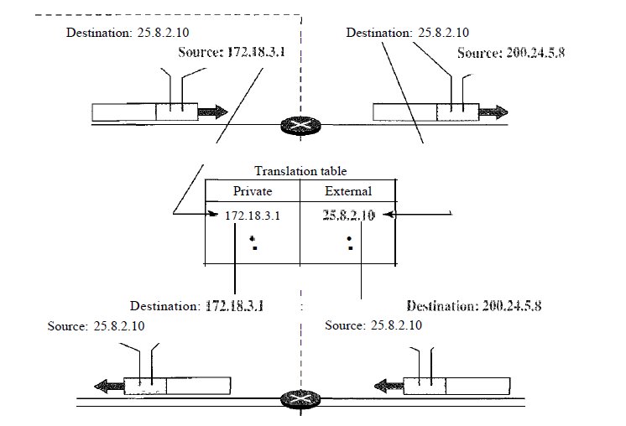
19.<number>

Slide 63
Using One IP Address
In its simplest form, a translation table has only two columns:
the private' address and the external address (destination address of the packet).
When the router translates the source address of the outgoing packet, it also makes note of the destination address-where the packet is going.
When the response comes back from the destination, the router uses the source address of the packet to find the private address of the packet.
19.<number>

Slide 64
In this strategy, communication must always be initiated by the private network.
The NAT mechanism described requires that the private network start the communication.
As we will see, NAT is used mostly by ISPs which assign one single address to a customer. The customer, however, may be a member of a private network that has many
private addresses.
In this case, communication with the Internet is always initiated from the customer site, using a client program such as HTTP, TELNET, or FTP to access the corresponding server program.
A private network cannot run a server program for clients outside of its network if it is using NAT technology.
19.<number>

Slide 65
Using a Pool of IP Addresses
Since the NAT router has only one global address, only one private network host can access the same external host.
To remove this restriction, the NAT router uses a pool of global addresses.
For example, instead of using only one global address (200.24.5.8), the NAT router can use four addresses (200.24.5.8, 200.24.5.9, 200.24.5.10, and 200.24.5.11).
In this case, four private network hosts can communicate with the same external host at the same time because each pair of addresses defines a connection.
19.<number>

Slide 66
However, there are still some drawbacks. In this example, no more than four connections can be made to the same destination.
Also, no private-network host can access two external server programs (e.g., HTTP and FTP) at the same time.
19.<number>

Slide 67
Using Both IP Addresses and Port Numbers
To allow a many-to-many relationship between private-network hosts and external server programs, we need more informationin the translation table.
For example, suppose two hosts with addresses 172.18.3.1 and 172.18.3.2 inside a private network need to access the HTTP server on external host 25.8.3.2.
If the translation table has five columns, instead of two, that include the source and destination port numbers of the transport layer protocol, the ambiguity is eliminated.
Table 19.4 shows an example of such a table.
19.<number>

Slide 68

Table 19.4 Five-column translation table
Note that when the response from HTTP comes back, the combination of source address (25.8.3.2) and destination port number (1400) defines the-private network host to which the response should be directed
19.<number>

Slide 69
19-2 IPv6 ADDRESSES
Despite all short-term solutions, address depletion is still a long-term problem for the Internet. This and other problems in the IP protocol itself have been the motivation for IPv6.
Note
An IPv6 address is 128 bits long.
19.<number>

